Slide 1
MOISTURE DETECTION

Slide 2
Project Details
In this Project, we are going to interface a Soil moisture sensor with Arduino. This sensor measures the volumetric content of water inside the soil and gives us the moisture level as output.
If the Moisture level is low then Buzzer gives us audible identification or alert.
LED also gives us happy or sad emoji reaction in this situation.

Slide 3
Required components
Moisture Sensor
Arduino Uno
16X2 LCD
Breadboard
10K potentiometer
220 ohm resistor
Led
Buzzer
Jumper Cable

Slide 4
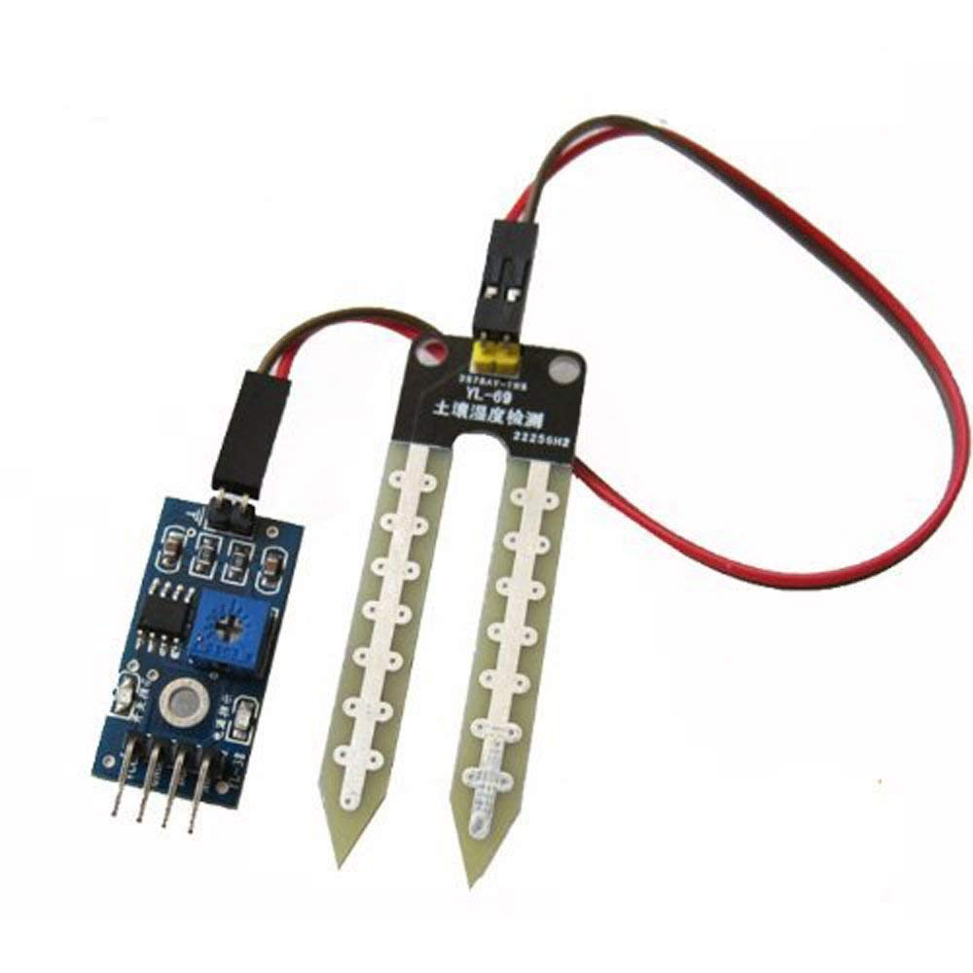
Moisture Sensor
YL-69 Soil moisture sensors measure the volumetric water content in soil knowing the exact soil moisture conditions on the fields by using some other property of the soil, such as electrical resistance, dielectric constant, or interaction with neutrons, as a proxy for the moisture content.

Slide 5
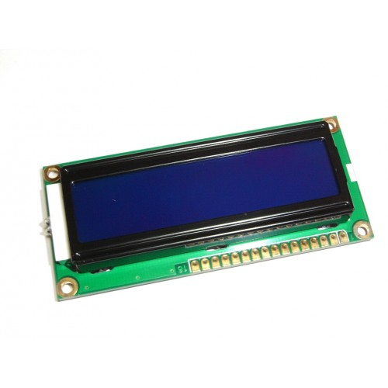
LCD
LCD (Liquid Crystal Display) screen is an electronic display module and find a wide range of applications. A 16x2 LCD display is very basic module and is very commonly used in various devices and circuits.

Slide 6
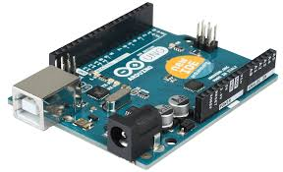
Arduino
Arduino is an open-source hardware. Arduino board designs use a variety of microprocessors and controllers.
The boards are equipped with sets of digital and analog input/output (I/O) pins that may be interfaced to various expansion boards or breadboards (shields) and other circuits

Slide 7
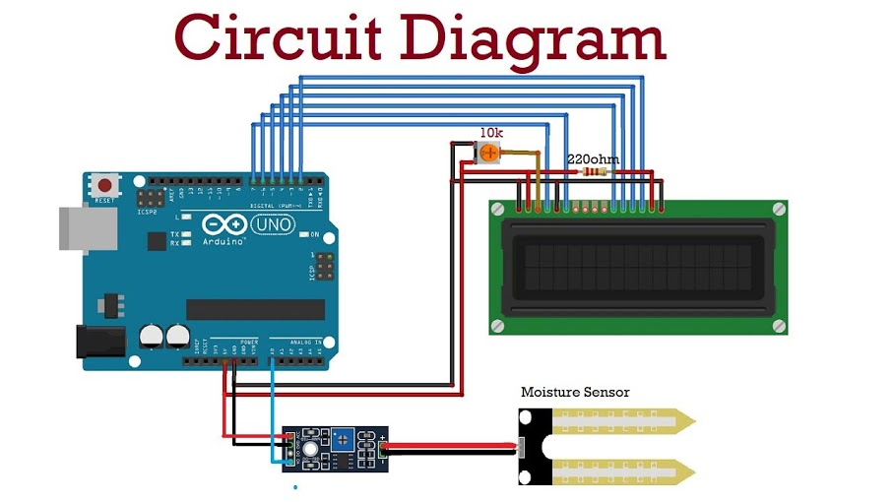

Slide 8
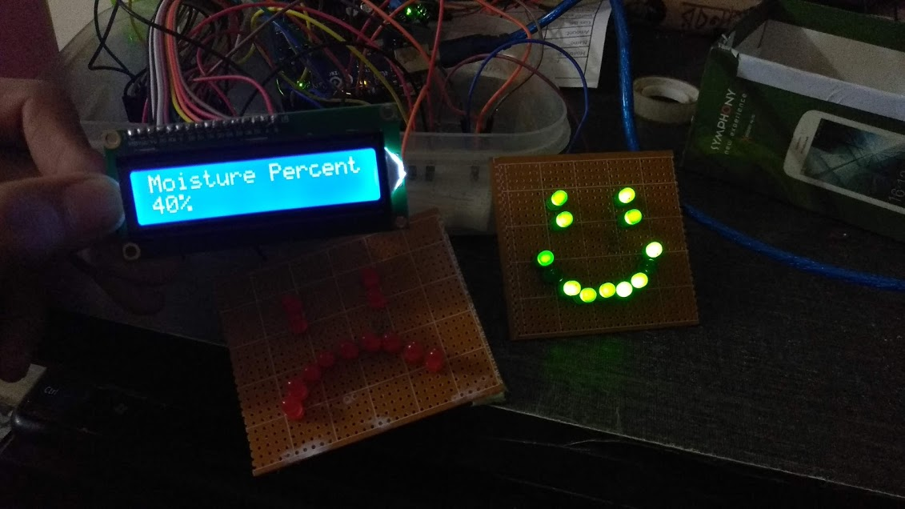
Project Output

Slide 9
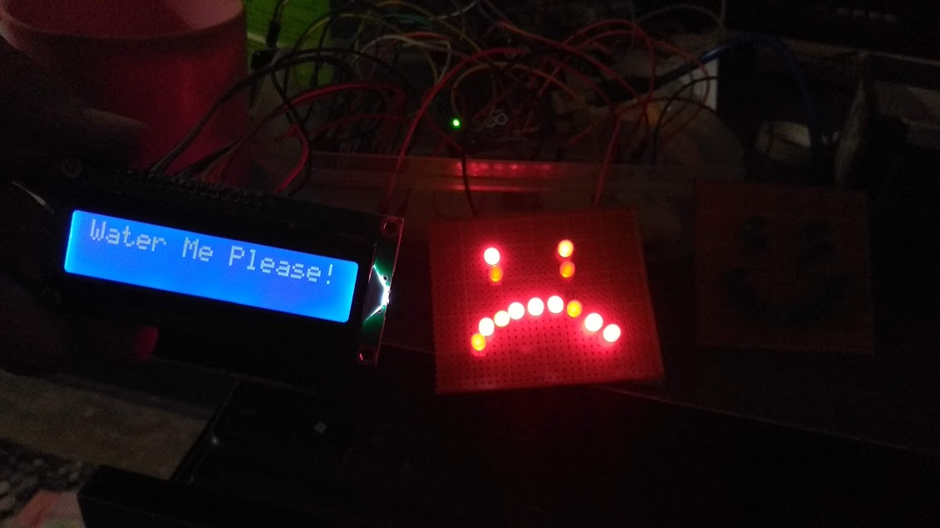
Project Output

Slide 10
Sketch
#include <LiquidCrystal.h>
LiquidCrystal lcd(12, 11, 5, 4, 3, 2);
int sensorPin = A0;
int sensorValue = 0;
int percentValue = 0;
void setup() {
Serial.begin(9600);
lcd.begin(16, 2);
pinMode(13,OUTPUT);
pinMode(8,OUTPUT);
pinMode(7,OUTPUT);
}
void loop() {
sensorValue = analogRead(sensorPin);
Serial.print("\n\nAnalog Value: ");
Serial.print(sensorValue);
percentValue = map(sensorValue, 1023, 200, 0, 100);
Serial.print("\nPercentValue: ");
Serial.print(percentValue);
Serial.print("%");

Slide 11
Sketch
if(percentValue >= 30)
{
digitalWrite(13,HIGH);
digitalWrite(8,LOW);
lcd.setCursor(0, 0);
lcd.print("Moisture Percent: ");
lcd.setCursor(0, 1);
lcd.print(percentValue);
lcd.print("%");
delay(2000);
lcd.clear();
lcd.print("WOW!!");
lcd.setCursor(0, 1);
lcd.print("I'm Happy now!");
delay(2000);
lcd.clear();
}
else
{
digitalWrite(8,HIGH);
digitalWrite(13,LOW);
tone(7,1000);
delay(1000);
noTone(7);
delay(1000);
lcd.setCursor(0, 0);
lcd.print("Water Me Please!");
delay(1000);
lcd.clear();
}
}

Slide 12
Problem Solving
Working with the sensors is sensitive.
One LCD, one Arduino, many wires and led were crushed.
Facing so many difficulties while setting all equipment.

Slide 13
Future Plan
We will try to develop this prototype as market level product.
We will implant voice module which will help user to interact with the plant.
We will try to build this prototype under IOT services.

Slide 14
Thank You

